Slide 1
Computer Networks Topologies
Dr. Mohammad Adly

Slide 2
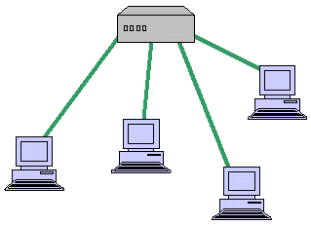
What is a Computer Network Topology?
The arrangement (structure) of the various elements of a computer network that depicts both physically and logically
Physical Topology: the physical way the network is wired (how computers connected to each other)
Logical Topology: the way messages are sent (how to send a message from machine to another)

Slide 3
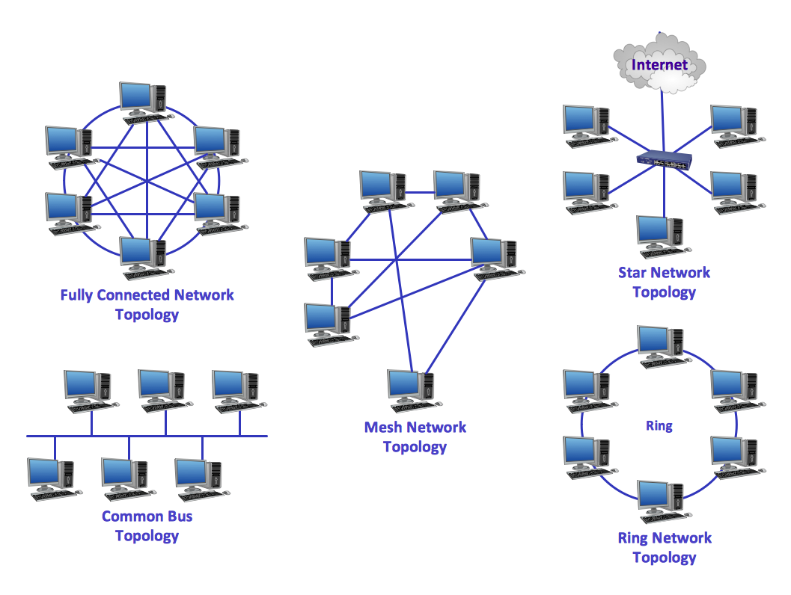
Basic Network Topologies
Point-to-point
Bus
Ring
Star
Mesh

Slide 4
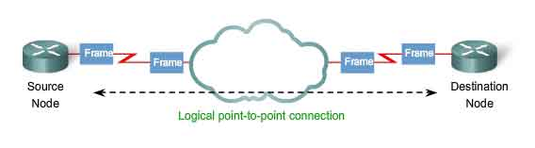
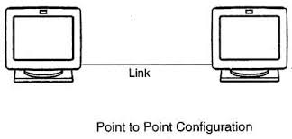
Point-To-Point Topology
Connection between two machines through a dedicated media link

Slide 5
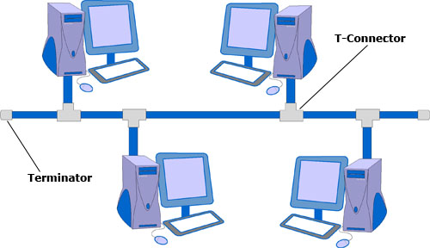
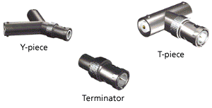
Bus Topology
Single cable functions as a shared communication media bus (Backbone)
Computers attach (tap) with an interface connector
Terminators at each end of the cable

Slide 6
BUS Topology
Advantages
  Simple to design
  Easy to install
  Inexpensive due to using
    Coaxial cable
    BNC Connectors
Disadvantages
  Less security (Allows sniffing)
  Slow during high traffic
  Lead to collisions

Slide 7
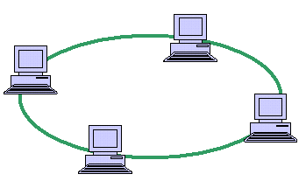
Ring Topology
Cable connects one node to another to form a ring
Messages travel through a ring always in the same direction
Data messages are transmitted in frames that circulates all the machines
Sent frame circulates back to source to acknowledge transmission and set free

Slide 8
Ring Topology
Advantages
  Simple to design
  Easy to install
  Inexpensive due to using
    Coaxial cable
    BNC Connectors
Disadvantages
  The entire network fails If one machine fails
  Expansion or reconfiguration affects operation
  Slow for big number of machines

Slide 9
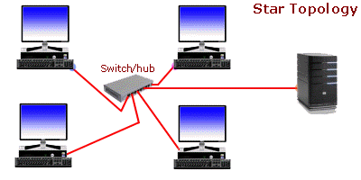
Star Topology
Each station is connected
directly to a central device
The connection is like
a number of point-to-point links
Central device is Hub or Switch
Switch is more recent technology and more secure device than hub

Slide 10
Star Topology
Advantages
  Network not affected if one machine fails
  Network expansion and reconfiguration is simple
  Troubleshooting is easy
Disadvantages
  If the central device fails all the network fails

Slide 11
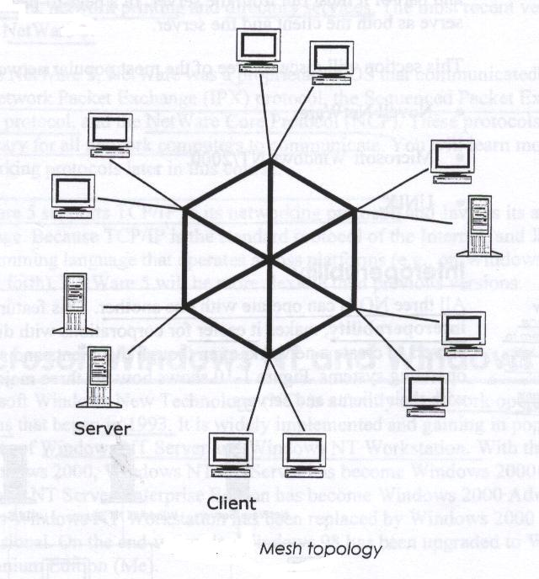
Mesh Topology
Connect all devices with multiple paths
Offers redundancy
N= n*(n-1)/2
  N= number of cables
  n= number of connected nodes

Slide 12
Mesh Topology
Advantages
  Fault tolerant
  Secure (High availability)
Disadvantages
  Expensive due to redundancy

Slide 13
Thank you

